Slide 1
When & How to Transition the Mentoring Relationship
Tsungai Chipato

Slide 2
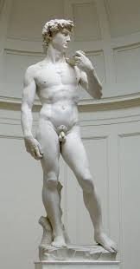
The purpose of mentoring…
To impact a person’s professional development by providing direction, motivation, support and education.
i.e. not to build the mentor’s career

Slide 3
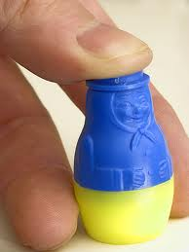
Tension in mentoring…
Trust vs. critique
Expert position = directive vs. interactive and responsive
Extension of mentor and/or mentee’s work
Investment of time vs. scarce resources
Mentor vs. supervisor
Power in relationship

Slide 4
Managing up!
Mentee to cultivate relationship*
Clarify values
Set goals
Manage information flow
Set agenda for meetings
Plan for eventual separation
*Drucker PF. Managing oneself. Harv Bus Rev. 1999; 77:64-74,185

Slide 5
Five Phases of Mentoring: Maturation
Induction
Cultivation
Maturation
Separation
Re-Definition
Mentor: Assist mentee to reach career goals
Mentee: Develop competency and move towards independence

Slide 6
Collaboration: A Special Situation
Induction
Cultivation
Maturation
Separation
Re-Definition
Collaboration work jointly
Grant proposal & research
Identify unique contribution
Clarify PI, multiple PI, authorship upfront
Plan for when/how to transition mentee to independence

Slide 7
Five Phases of Mentoring: Separation
Induction
Cultivation
Maturation
Separation
Re-Definition
Mentor: Relinquish control over and participation in mentee’s professional life
Mentee: Move career forward and give up security of mentor

Slide 8
Five Phases of Mentoring: Re-Definition
Induction
Cultivation
Maturation
Separation
Re-Definition
Mentor: Support as a colleague
Mentee: Ditto

Slide 9
Transition Assessment…
Who is PI on grants?
Mentor vs. mentee
Is mentor still co-investigator on mentee’s grants?
Are you skills/experience still necessary?
Is mentor co-author on manuscripts
If yes, does mentor need to be senior author?
Among peers, who is identified with work?

Slide 10
Timing of Transition…
Training Period | Physician-Researcher | PhD Researcher
Medical or Doctoral Studies | 4-6 years | 4-6 years
Residency | 3-5 years | N/A
Post-Doctoral Training | 2-3 years | 2-3 years
Junior Faculty | 4-6 years | 4-6 years
Mid-Career Faculty | 4-6 years | 4-6 years
Total Training Period | 17-26 years | 14-21 years

Slide 11
Anticipated Challenges & Resolution Strategies
Challenges
Competition
Jealousy
Prolonged dependence
Conflicting interests
Changing institutions
Mentee or mentor
Resolution Strategies
Re-clarify mentee goals
Seek council with other mentors
Consider joint mentoring session with mentorship team, department chair
Clear, honest communication
Head off confrontation early

Slide 12
Institutional Support of Mentoring Transition
Old Model
Reward publications
1st and last authorship
Reward grants
No direct measurement of mentoring quantity or quality
New Model
Reward for mentoring
Number
Success of mentees
Publication
Grant support
International recognition
Direct training/mentoring programs
“Old Model” metrics

Slide 13
Thank You!

